Slide 1
Emergency SOS using centrality measure
Course Code: CSE3021 – Social and Information Networks
Slot: A1 + TA1
Professor: Dr. W.B.Vasanth
Akshat Shrivastava 16BCE0692
Arpan Shrivastava 16BCE2133
Jivjot Singh 16BCI0174
Naman Singh Bhandari 16BCE0733
Simran Koul 17BCE2210

Slide 2
INTRODUCTION
How would you know whom to contact in emergency situations ,who can spread your news to a wide number of people you trust ? We face a lot of situation just like this in our daily life…..but we never try to find a solution to this.
That’s why we are here to solve your problem. Our project focuses on how to manage these types of problems, whom to contact and how far these messages should deliver.
Suppose you have 2% battery in your mobile and you are in a emergency situation first question which comes to mind is “Whom would I contact so as to get maximum help?”. So basically you would need to contact a person who knows a lot of people and to whom you can trust, after contacting him you will be starting getting messages if the message number increases you will get confused ,so to avoid this you can set a number of people he/she shares. Secondly which message to read first (your most trusted)because you have a little battery left.
Our project orbits around all these situations and problems which we face daily. And as it is faced by everyone in a daily basis we can extend this project to greater means with a proper skillset.

Slide 3
ABSTRACT
This whole project is based on centrality and how it can be effectively used in daily life during emergency situations. Here , in this project, every person acts as a node. So when a person contacts an appropriate center which will multicast to different other nodes, this means that when a node will contact an appropriate center which will multicast to other nodes so that help may reach the emergency critical situation as soon as possible. The person who receives the message of the individual in need should neither have a very small group of people linked to him/her that not everyone will be aware, and neither a very large group of people resulting in denial of service . This means that an appropriate center will be one which has neither a very small centrality that not everyone who need to know wouldn't be aware, and neither a very large centrality which may result in a denial of service towards the individual in need. This centrality measure is a practical approach to problems which can be as casual as a punctured tire or as serious as someone's life. This measure ,if applied seriously, can make sure that people get help when in need and hence reduce crime in extreme cases.

Slide 4
ABSTRACT
This centrality measure can act as a life guard in situations that people may not be able to comprehend with. This may save them from life threatening situations . When an individual is in trouble and has no one to ask for help in their surroundings, they can inform a particular node and that node makes sure that the message is circulated and hence help is provided within no time. This, if put to extreme and professional use, can reduce criminal cases and also help women who need help if they feel that they are being stalked or in some cases prevent rapes to a large extent. This measure can actually be put to a great use and solve numerous problems. People won't be worrying if there phones run out of batteries, as they have already informed a particular node and are certain that through this effective measure, a help will be provided to them for sure. They will feel safe and secure if we use this centrality measure and bring them safety and security.

Slide 5
Methodology used
The degree centrality is very good in calculating immediate neighbors but fails in the second level. The closeness centrality is very good for compute shortest distance, but takes into consideration each and every node (even the furthest away - which is immaterial in emergency time). We hence strike a balance between the two, by calculating both and adding weights. The overall measure should not be too small, else sufficient people won't be informed. Similarly, the overall measure should not be too large else too many worthless disturbing calls will come during emergency. Our final measure is the optimization of the value within the range. In the course of our project, along with representing the above methodology mathematically, we shall theoretically and mathematically compute the range and also write the code to find the node which maximizes the optimality.

Slide 6
WORK DONE AND IMPLEMENTATION
Firstly , a dataset is made by using the kaggle.com which has predefined datasets. This will consist of names and birth significance ,birth year ,death year etc. and its target node. Thus the nodes will be evaluated using different measures.
The dataset will consist of the distances between nodes with a direct path between them. For nodes that have only indirect paths between them, the shortest path will be calculating by adding the distances of the edges in this path.

Slide 7

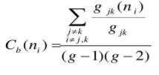
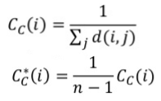
Analysis will be done on the basis of:
1.Degree:
2. Betweenness:
3. Closeness:
Using this top 20 nodes will be listed out. So anyone if in an emergency can reach out to anyone of them for help.
There is also a visualization tool called GEPHI which we will be using for a proper see through of the project.

Slide 8
DATASET USED
a. The reference data set being used is taken from kaggle.
b. Our project is an innovative self created idea, not referenced from anywhere else. The justification of validity of need of such a project, lies in the immense time shortage and immediate action requirement during critical emergency times.

Slide 9
HARDWARE AND SOFTWARE REQUIREMENTS:
A laptop/desktop with 4GB of ram along with a java 1.8 or higher , python idle 3.7 and networkx library.
Tools used:
The only tool we have sed comprises of gephi graph visualization which consist of jdk home prompt and several python libraries.

Slide 10
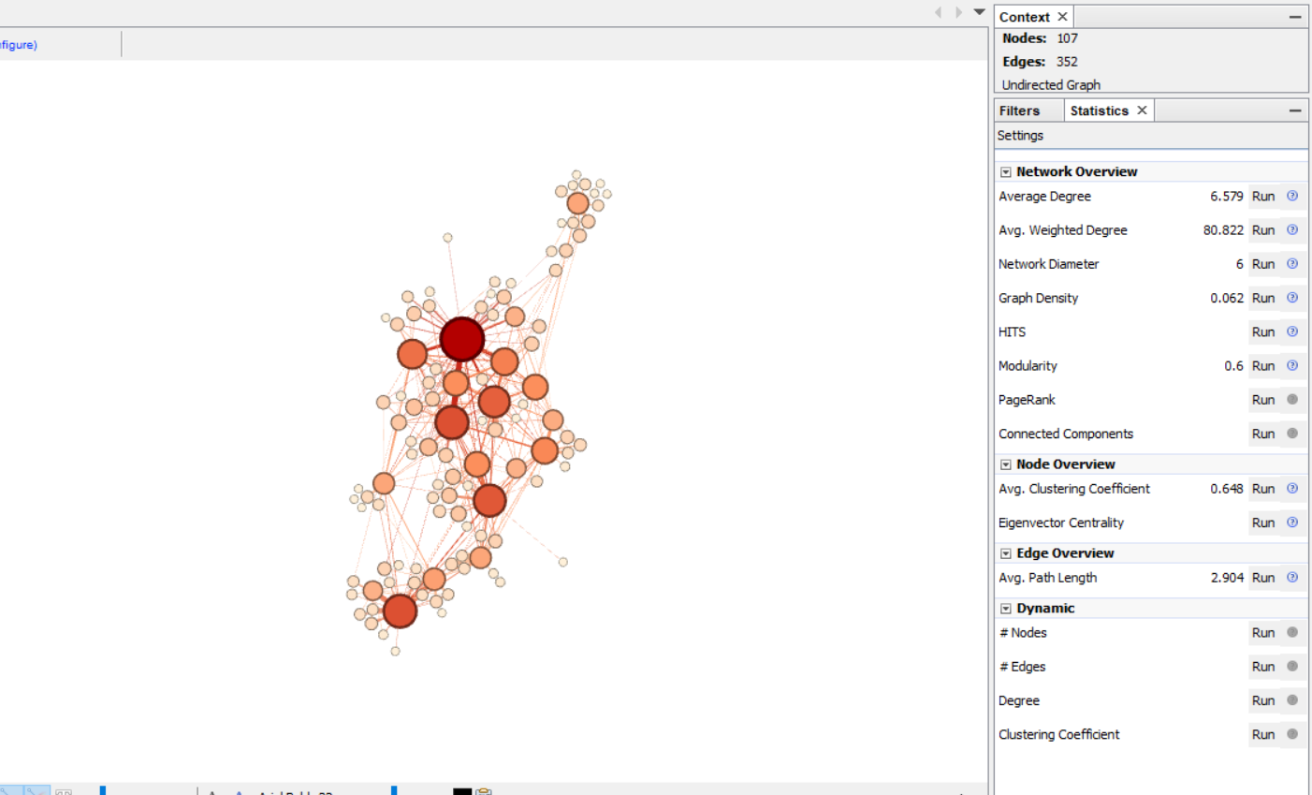

Slide 11
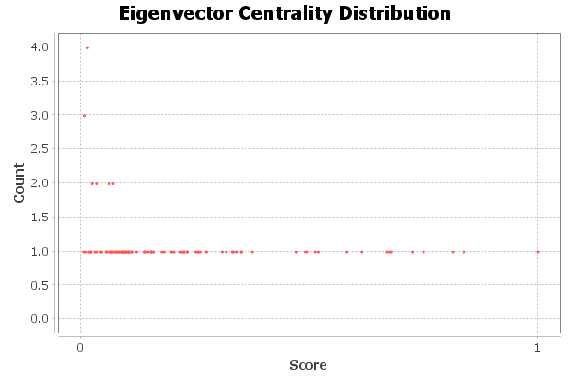

Slide 12
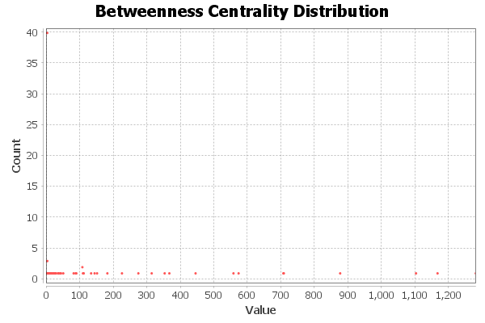

Slide 13
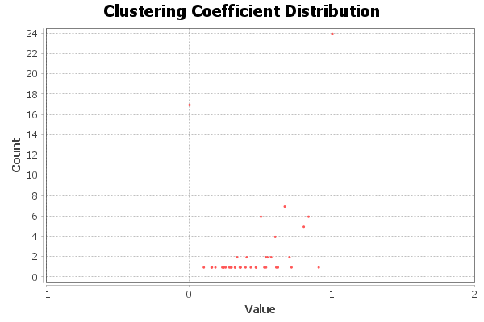

Slide 14
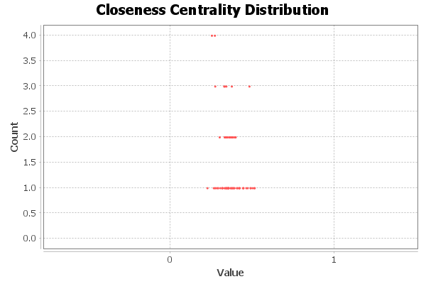

Slide 15
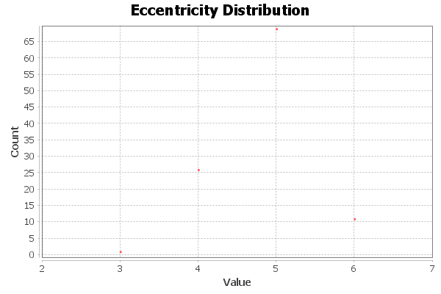

Slide 16
Conclusion
Through our project we can come to a conclusion that centrality measures can be used vastly for emergency purposes. The person will know whom to contact for immediate results.
This is done through different measurements like
1.Betweenness centrality
2.Eigen vector centrality
3.Network diameter
4.Graph density
5.Avg clustering coefficient
6.Avg path length
7.Triadic closure
8.Shortest path
The person will have the list of names within seconds and he/she can get help.

Slide 17
References
1. https://snap.stanford.edu/data/roadNet-TX.html
2. www.kaggle.com
3. http://journals.sagepub.com/doi/10.1177/1745691612442904
4. https://ieeexplore.ieee.org/xpl/mostRecentIssue.jsp?punumber=7517494
5. https://ieeexplore.ieee.org/xpl/mostRecentIssue.jsp?punumber=7457420
6. https://journals.aps.org/pre/abstract/10.1103/PhysRevE.64.016132
7. https://www.journals.uchicago.edu/doi/abs/10.1086/228631

Slide 18
Thank You!

